Slide 1


Diffusion Models
Stochastic Process
Wennan Wang, Jingrong Guan, Lecong Ding
May, 2024

Slide 2

目录
CONTENTS
1
Background
4
Conclusion
2
Models
5
Reference
3
Improvements

Slide 3
1. Background
The concept of the models ffrst appeared in statistical physics, used to describe the process of particles moving.
Introduction
Background
2015
In 2015, Sohl-Dickstein introduced this concept to machine learning. This became one of the key breakthroughs in diffusion modelling.
DDPM
Score matching
In 2020, Jonathan Ho proposed the Denoising Diffusion Probabilistic Model(DDPM). This technique led to a huge improvement in the quality of the generated images.
Improvements
2020
Conclusion
Since then, diffusion models have shown potential in more and more fields, especially the high-resolution image generation...
Reference
&
Contribution

Slide 4
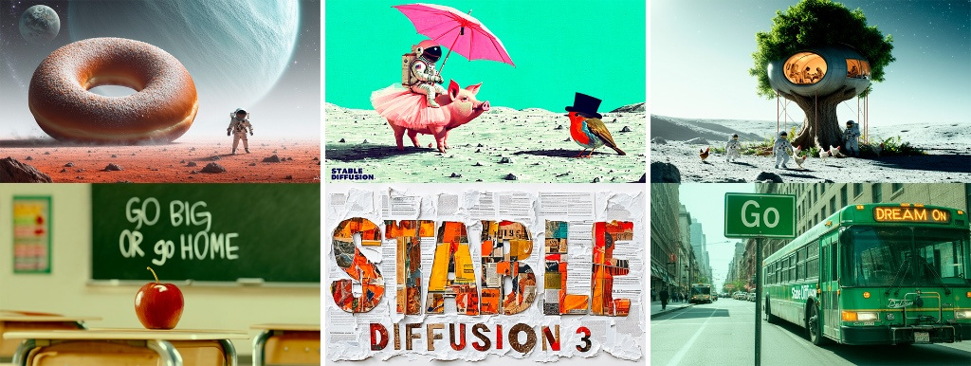
2.Motivation
Nowadays, diffusion models have become the first choice of Stability AI, OpenAI, Google Brain, etc. to build models. As well, many people have already used these generative models in their lives, such as DALL-E 3, Stable diffusion 3, Sora , etc.
Therefor, our aim is to understand the principle and explore the improvements and application areas of diffusion models based on the stochastic process course of this semester.
Introduction
Background
DDPM
Score matching
Improvements
Conclusion
Reference
&
Contribution
Generated samples from Sable Diffusion 3

Slide 5
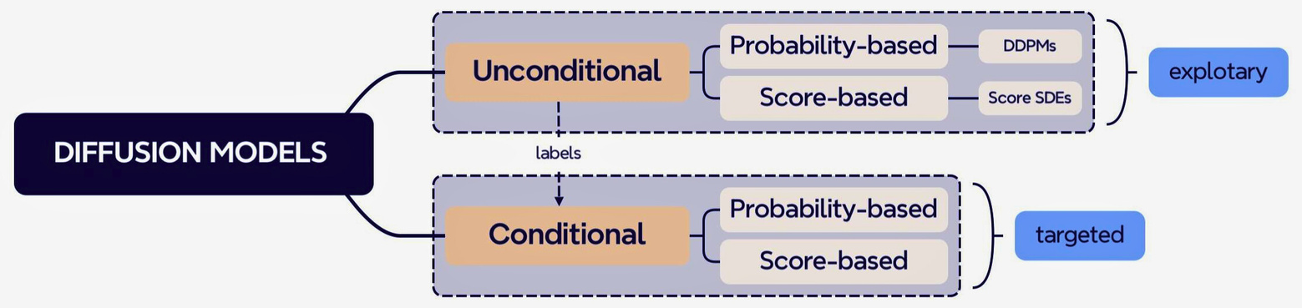
1.Classification
Typically, we classify diffusion models into two main categories: unconditional and conditional diffusion models.
Introduction
Background
DDPM
Score matching
Unconditional
Conditional
Improvements
Generating data samples relies on self-information. Unconditional models can be further classiffed into probability-based diffusion models and score-based diffusion models. The generation is innovative and versatile.
The conditional model introduces additional information to train the network. This enhances the performance and makes the output more speciffcally, and it’s the most commonly used means of generation nowadays.
Conclusion
Reference
&
Contribution

Slide 6
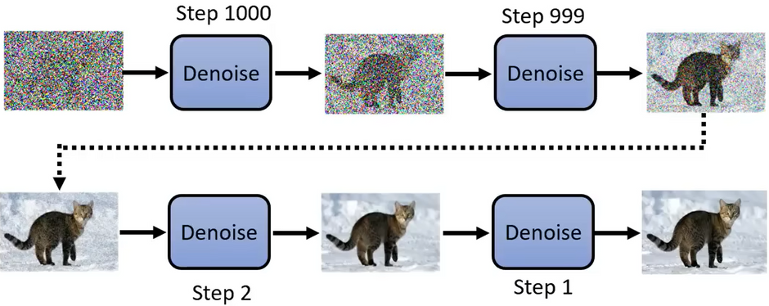
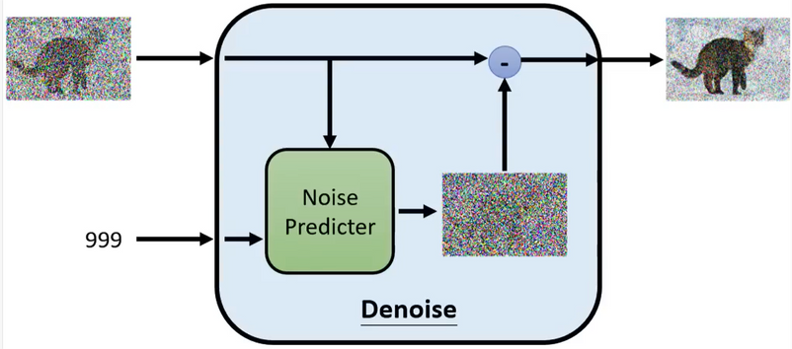
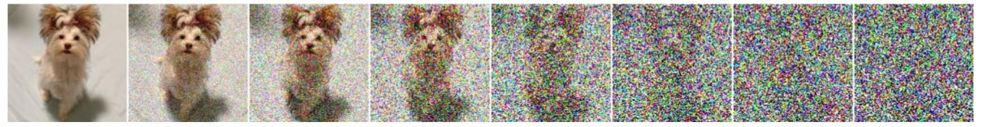
2.Overview of the model
How to generate an image?
Introduction
Background
DDPM
Score matching
How to practice the Noise Predicter?
Improvements
Forward process: Add noise
Data distribution
Gaussian noise
Conclusion
Reference
&
Contribution
Model distribution
Gaussian prior
Backward process: Learn to denoise

Slide 7
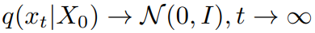
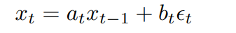
1.Forward process
Introduction
Markov chain
Limiting distribution
Background
DDPM
Score matching
Setting of coefficients
Improvements
Conclusion
Reference
&
Contribution

Slide 8
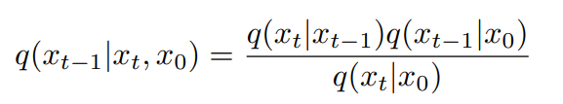
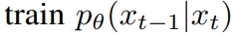
2.Backward process
Introduction
Bayesian formula
Deep learning net
Background
DDPM
Score matching
Model setting
Improvements
Conclusion
Reference
&
Contribution

Slide 9
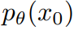
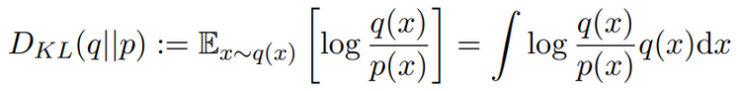
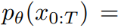
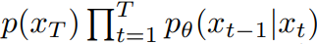
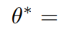
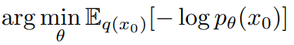
3.Loss function
Introduction
Target function
Kullback-Leibler divergence
Background
DDPM
Score matching
Optimization of loss function
Improvements
Conclusion
Reference
&
Contribution

Slide 10
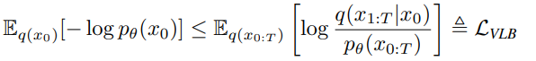
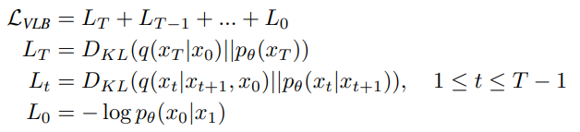
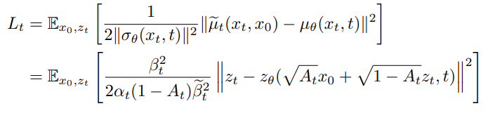
4.VLB
Introduction
VLB
Decomposition of VLB
Background
DDPM
Score matching
Improvements
Conclusion
Reference
&
Contribution

Slide 11
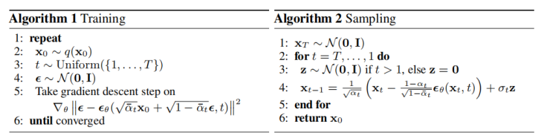
5.Algorithm
Introduction
Background
DDPM
Score matching
Improvements
Conclusion
Reference
&
Contribution

Slide 12
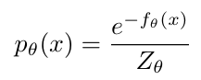
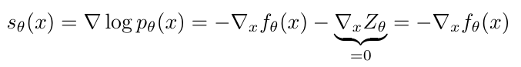
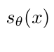
1.Score function
Introduction
Intuition: Avoid direct computation of the normalizer of p.d.f.
Background
DDPM
Score matching
Improvements
is called the score function
Conclusion
Background: Energy based model from Statistical physics.
Reference
&
Contribution

Slide 13
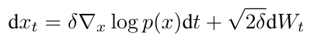
2. Score-matching with Langevin dynamics
Langevin dynamics provides an MCMC procedure to sample from data distribution P_data(x)
Given any prior distribution x0∼π(x), the iteration follows:
Introduction
Background
DDPM
Score matching
Improvements
When δ → 0 and T → ∞, the process has P_data(x) as stationary distribution. The computation only concerns about the score function of P_data(x)
It allows us to generate samples from a known but maybe complex distribution, just starting from a simple one, like gaussian.
Conclusion
Reference
&
Contribution

Slide 14
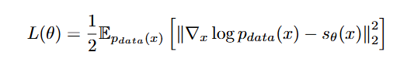
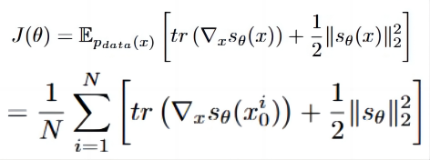
2. Score-matching with Langevin dynamics
Disadvantage: The real distribution P_data(x) is unknown,
nor is the score function.
Alternative One(Time-independent):
1. Build up a neural network: sθ (x) = ∇_x log P_θ (x) to
approximate ∇_x log P_data (x).
2. Choice of Loss function: Fisher divergence
To minimize the mean-square distance.
3. Substitute: L(θ) = J(θ) + C, where
Introduction
Background
DDPM
Score matching
Improvements
Conclusion
Reference
&
Contribution

Slide 15
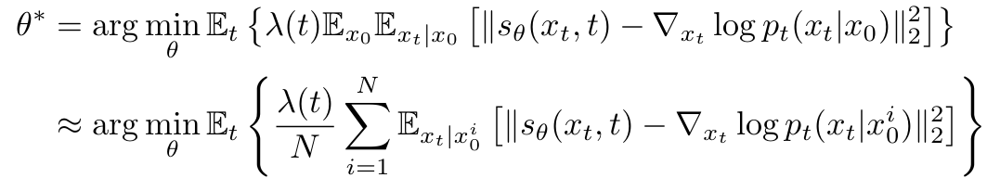
2. Score-matching with Langevin dynamics
Alternative Two(Time-dependent):
1. Build up a neural network:
sθ (x_t,t) = ∇_x log P_θ (x_t,t)
to approximate ∇_x log P_data (x_t,t).
2. Choice of Loss function: Fisher divergence
To minimize the mean-square distance. Where
λ : [0, T ] → R+ is weighting function,
t is sampled from U[0, T].
Introduction
Background
DDPM
Score matching
Improvements
Conclusion
Reference
&
Contribution

Slide 16
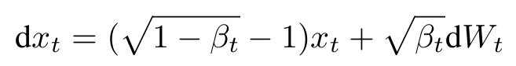
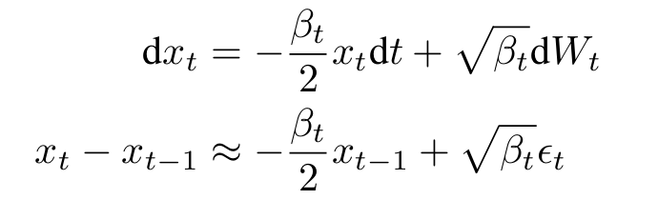
3. Score based model with diffusion process
The adding-noise process can be generalized
as a solution of SDE:
Introduction
Background
DDPM
e.g. DDPM is a discrete version of an SDE:
Score matching
In empirical practice, {βt} is very small that βt ∈ (0.01, 0.1). It can simplified as:
Improvements
Conclusion
Reference
&
Contribution

Slide 17
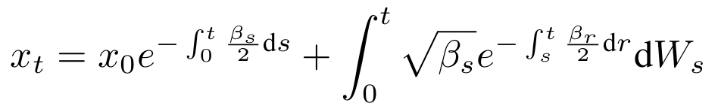
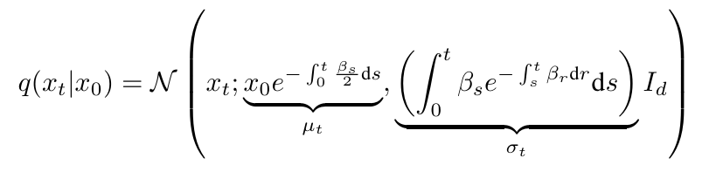
3. Score based model with diffusion process
2. There is an analytic solution for x_t:
Introduction
Background
DDPM
3. The marginal distribution of x_t is:
Score matching
Improvements
Conclusion
4. When t→∞, µ_t→0, σ_t=O(1).
The same as discrete DDPM !!!
Reference
&
Contribution

Slide 18
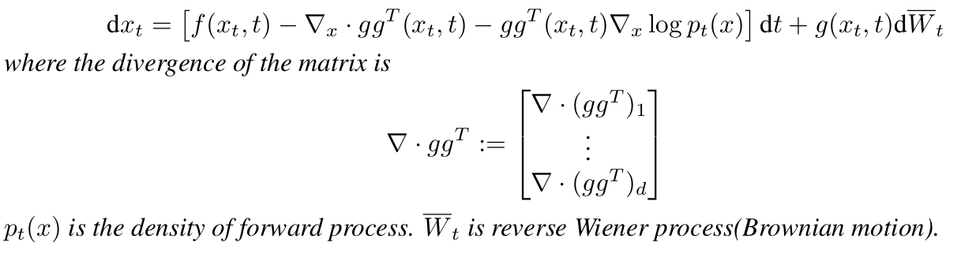
4. Reverse SDE and probability flow ODE of diffusion process
Setup:
The white noise N(0,I) as the limit of the forward process,
if this process is invertible, we can first easily sample from
N(0,I), and generate image/vedio data via reverse transform.
Introduction
Background
Theoretical results:
1. For general SDE, there is a corresponding reverse SDE.
DDPM
Score matching
Improvements
Conclusion
Reference
&
Contribution

Slide 19
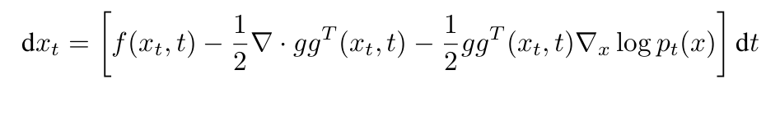
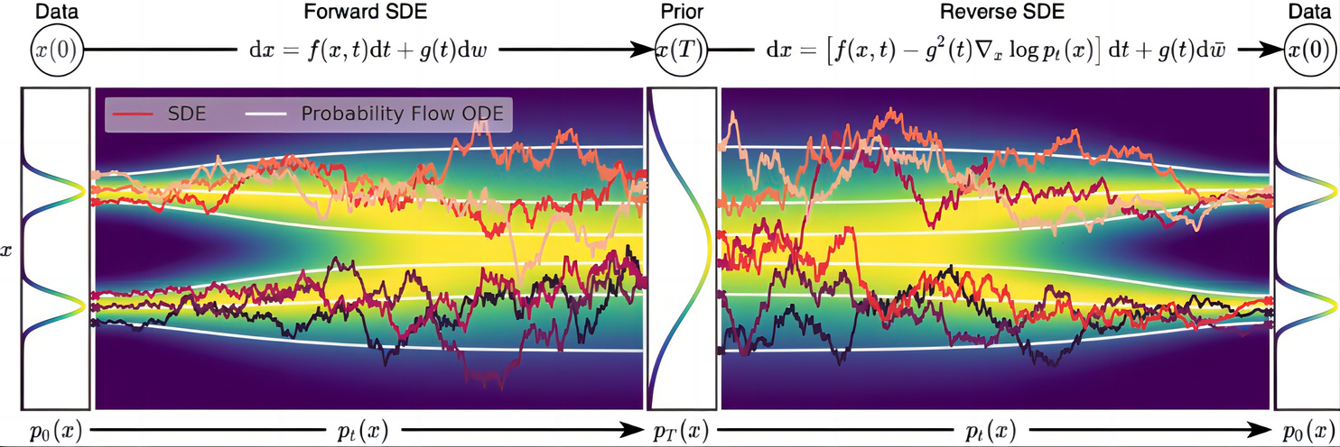
4. Reverse SDE and probability flow ODE of diffusion process
Theoretical results:
2. For general SDE, there is a 1-1 correspondence to a type
of ODE, called probability flow ODE. This ODE preserves the
same marginal distribution as the SDE, given the same
initial distribution.
Introduction
Background
DDPM
Score matching
Intuitive understanding:
Improvements
Conclusion
Reference
&
Contribution

Slide 20
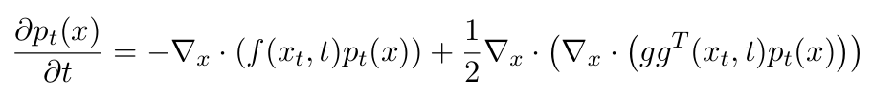
5. Score-matching with Reverse SDE and probability flow
Key Idea:
With reverse SDE and probability flow ODE, we first
sample from limit distribution(e.g. N(0,I)), and then
solve the reverse SDE or ODE using numerical method
to generate image/video data.
New difficulty:
Two equations involve both the term about marginal
distribution P_t(x) of forward process. But for general
diffusion process, this distribution is unknown !!!
To solve P_t(x), equivalent to a complex PDE
(Fokker-Planck equation), is infeasible.
Introduction
Background
DDPM
Score matching
Improvements
Conclusion
Reference
&
Contribution

Slide 21
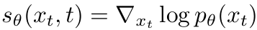
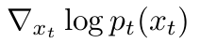
5. Score-matching with Reverse SDE and probability flow
Solution with score-matching:
1. use a neural network
to estimate
2. The conditional probability P_t(x_t|x_0) is usually known!
The design of loss function is based on this fact!
3. Choose a positive weighting function λ : [0,T] → R+, and let
time variable t~U[0,T] uniformly distributed,
the optimization step is concluded as:
Introduction
Background
DDPM
Score matching
Improvements
Conclusion
4. Aim: To minimize the average ℓ2 distance between
S_θ and ∇_x log P_t(x_t)
Reference
&
Contribution

Slide 22
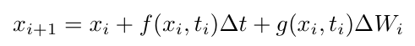
6. Numerical method for SDE and probability flow ODE
Use the simple Euler-Maruyama scheme:
1. For forward SDE:
Introduction
Background
DDPM
where
Score matching
2. For probability flow ODE(reverse):
Improvements
Conclusion
Reference
&
Contribution

Slide 23
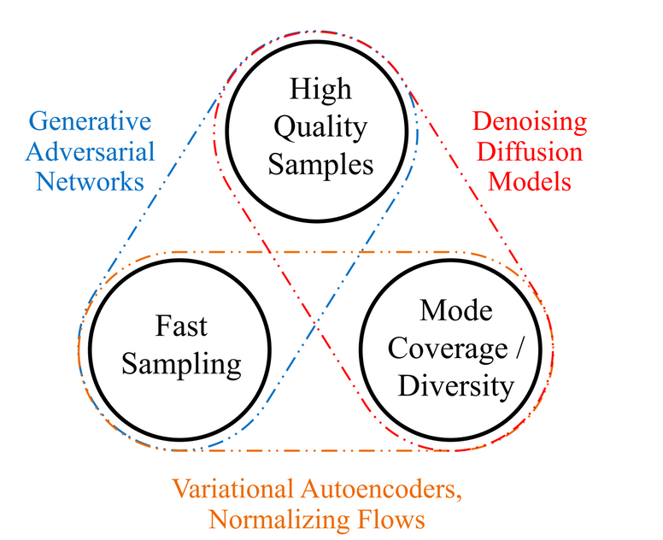
1.Sampling acceleration method
For an image generation model, there are three considerations:
1) high quality samples,
2) generating diversity,
3) efffcient and fast sampling.
However, it is often difffcult to trade-off between these three.
Introduction
Background
DDPM
Score matching
Improvements
Generative learning trilemma
Diffusion models require thousands of sampling steps, which leads to very slow training and inference.
Conclusion
50,000 images of 256*256 on 1 GPU≈ 1,000 hours
Reference
&
Contribution

Slide 24
1.1 "Skipping steps"
In the generating process, the close steps give the similar distribution.Can we skip some steps?
Introduction
Background
DDPM
Score matching
Improvements
Conclusion
Reference
&
Contribution

Slide 25
1.1 "Skipping steps"
In the generating process, the close steps give the similar distribution.Can we skip some steps?
Introduction
No! Because DDPM is based on the Markov property!
Background
DDPM
Score matching
Improvements
Conclusion
Reference
&
Contribution

Slide 26
1.1 "Skipping steps"
In the generating process, the close steps give the similar distribution.Can we skip some steps?
Introduction
No! Because DDPM is based on the Markov property!
Background
But if we make the process not depend on Markov property anymore?
DDPM
Score matching
Improvements
Conclusion
Reference
&
Contribution

Slide 27
1.1 "Skipping steps"
In the generating process, the close steps give the similar distribution.Can we skip some steps?
Introduction
No! Because DDPM is based on the Markov property!
Background
But if we make the process not depend on Markov property anymore?
DDPM
Denoising diffusion implicit model(DDIM) do what we want!
Score matching
Improvements
Conclusion
Reference
&
Contribution

Slide 28
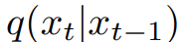
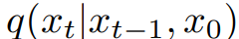
1.1 "Skipping steps"
In the generating process, the close steps give the similar distribution.Can we skip some steps?
Introduction
No! Because DDPM is based on the Markov property!
Background
But if we make the process not depend on Markov property anymore?
DDPM
Denoising diffusion implicit model(DDIM) do what we want!
Score matching
Main idea:
Improvements
Change
to
,
Conclusion
Then, set any probability distribution that satisfies:
Reference
&
Contribution

Slide 29
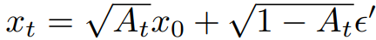
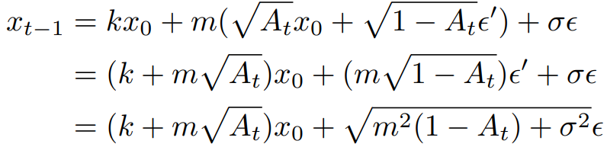
1.1 "Skipping steps"
Denoising diffusion implicit model(DDIM)
Introduction
DDIM is a sampling model, based on the traing process of DDPM. As a reason, we must follow the equation we used in the forward process.
Background
DDPM
Thus we use the method of undetermined coefffcients, assuming that
Score matching
Then we have
Bring back
Improvements
Conclusion
Reference
&
Contribution

Slide 30
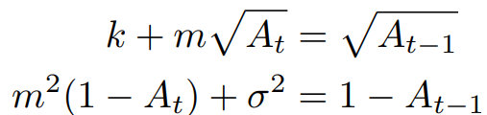
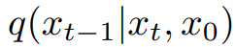
1.1 "Skipping steps"
Denoising diffusion implicit model(DDIM)
Introduction
Bring back to the condition, we get
Background
DDPM
Easily, we get the new distribution of
Score matching
Improvements
Since we no longer need to obey the Markov property, we obey the following form:
Conclusion
Reference
&
Contribution

Slide 31
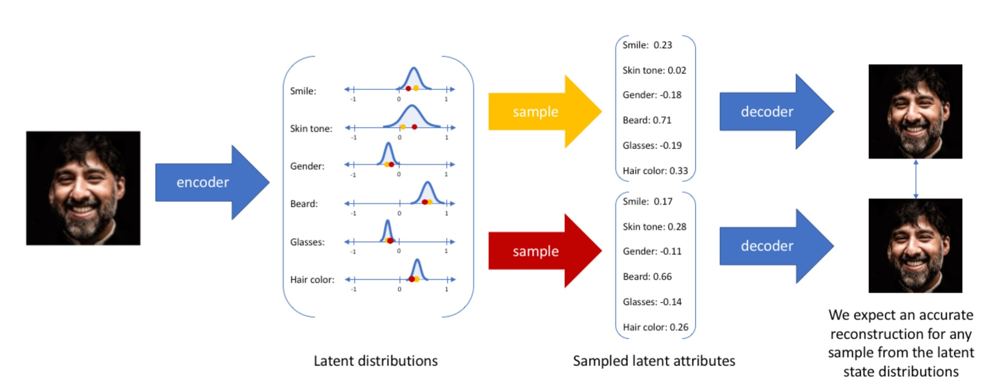
1.2 Integration with other generative models
Since GAN approximates the generated samples to the real samples through the confrontation between the generator and the discriminator, it also often faces pattern collapse. Combining GAN with DM can not avoid this.
Therefore the more common approach nowadays is to combine Variational Autoencoders(VAE) with DM.
Introduction
Background
DDPM
Score matching
VAE:
Improvements
Conclusion
Reference
&
Contribution

Slide 32
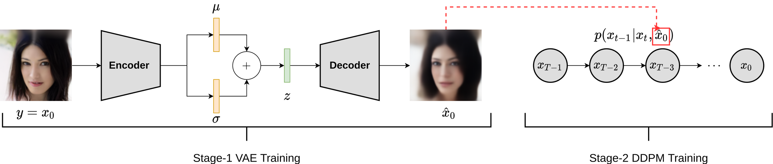
1.2 Integration with other generative models
DiffusionVAE:
Introduction
Background
DDPM
Score matching
In combination with the diffusion model, not only can the number of steps required for the convergence of the diffusion model be accelerated by appropriately reducing the dimensionality of the training data, which in turn speeds up the speed when sampling. It is also possible to make the image have higher clarity than VAE by generating multiple steps.
Improvements
Conclusion
Reference
&
Contribution

Slide 33
2.Outlook and future opportunities
Efffciency Issues
Reduce the sampling steps
Network lightweighting
Introduction
Background
Robustness and Generalization
real-world images may inherently have a wide variety of situations
upgraded the dimension of sampling from 2D to 3D
DDPM
Score matching
Integration of LLMs and Diffusion Models
Current large language models are capable of generating high-quality text, but for practical use it is necessary to have the model generate text that meets our desired requirements. Existing methods have strong limitations. The combination of a continuous diffusion model with a non-autoregressive language model can perform complex control tasks in a simpler way.
Improvements
Conclusion
Reference
&
Contribution

Slide 34
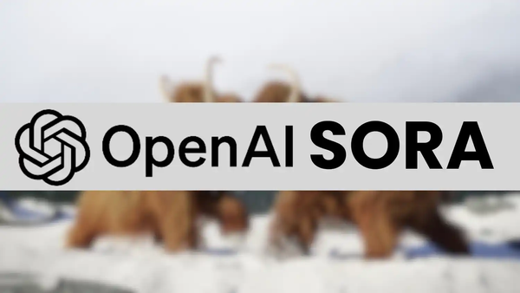

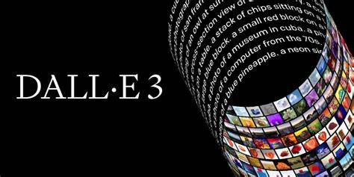
3.Applications
Generation
The most important application of diffusion models is still in the generative domain. Generate creative, high-quality images or videos. The transformation of text and images is achieved. In addition, the diffusion model can also be used for image restoration and enhancement.
Introduction
Background
DDPM
Score matching
Forecasting
The core of forecasting is the generation of temporal data samples for speciffc purposes. In this regard, diffusion model serves as a powerful generative framework. A wide variety of predictive models based on diffusion models are available for a wide range of domains.
Improvements
Conclusion
Reference
&
Contribution

Slide 35
1.Conclusion
Introduction
Score matching
Background
DDPM
Improvements
Background
Score function
Score-matching with Langevin dynamics
Score based model with diffusion process
Reverse SDE and probability flow ODE of diffusion process
Score-matching with Reverse SDE and probability flow
Numerical method for SDE and probability flow ODE
DDPM
"Skipping steps",DDIM
Integration with other generative models
Outlook and future opportunities
Applications
Introduction
Motivation
Classification
Overview
Forward process
Backward process
Loss function
VLB
Algorithm
Score matching
Improvements
Conclusion
Reference
&
Contribution

Slide 36
Reference
[1] William K. Bertram, Analytic solutions for optimal statistical arbitrage trading, Physica A: Statistical Mechanics and its Applications, Volume 389, Issue 11, 2010, Pages 2234-2243, ISSN 0378-4371, https://doi.org/10.1016/j.physa.2010.01.045.
[2] Santos, Javier E. and Yen Ting Lin. “Using Ornstein-Uhlenbeck Process to understand Denoising Diffusion Probabilistic Model and its Noise Schedules.” ArXiv abs/2311.17673 (2023): n. pag.
[3] Song, Yang, Conor Durkan, Iain Murray and Stefano Ermon. “Maximum Likelihood Training of Score-Based Diffusion Models.” Neural Information Processing Systems (2021).
[4] Turner, Richard E., Cristiana-Diana Diaconu, Stratis Markou, Aliaksandra Shysheya, Andrew Y. K. Foong and Bruno Mlodozeniec. “Denoising Diffusion Probabilistic Models in Six Simple Steps.” ArXiv abs/2402.04384 (2024): n. pag.
[5] Ho, Jonathan, Ajay Jain and P. Abbeel. “Denoising Diffusion Probabilistic Models.” ArXiv abs/2006.11239 (2020): n. pag.
[6] Yang, Yiyuan, Ming Jin, Haomin Wen, Chaoli Zhang, Yuxuan Liang, Lintao Ma, Yi Wang, Cheng-Ming Liu, Bin Yang, Zenglin Xu, Jiang Bian, Shirui Pan and Qingsong Wen. “A Survey on Diffusion Models for Time Series and Spatio-Temporal Data.” (2024).
[7]Nichol, Alex and Prafulla Dhariwal. “Improved Denoising Diffusion Probabilistic Models.” ArXiv abs/2102.09672 (2021): n. pag.
[8] Sohl-Dickstein, Jascha Narain, Eric A. Weiss, Niru Maheswaranathan and Surya Ganguli. “Deep Unsupervised Learning using Nonequilibrium Thermodynamics.” ArXiv abs/1503.03585 (2015): n. pag.
[9] Xiao, Zhisheng, Karsten Kreis and Arash Vahdat. “Tackling the Generative Learning Trilemma with Denoising Diffusion GANs.” ArXiv abs/2112.07804 (2021): n. pag.
[10] Dhariwal, Prafulla and Alex Nichol. “Diffusion Models Beat GANs on Image Synthesis.” ArXiv abs/2105.05233 (2021): n. pag.}
Introduction
Background
DDPM
Score matching
Improvements
Conclusion
Reference
&
Division

Slide 37
Contribution
Introduction
Wennan Wang
Details in score-based diffusion models and DDPM
Background
DDPM
Jingrong Guan
Background and improvements(DDIM & VAE)
Score matching
Improvements
Lecong Ding
Conclusion
Details in denoising diffusion probability model
Reference
&
Division

Slide 38
THANK YOU
Wennan Wang, Jingrong Guan, Lecong Ding

